Slide 1
PERULANGAN
LOOP
PBO
“ TANWIR ”

Slide 2
Kenapa belajar loop?
Cetak “S1TI”
Cetak “S1TI”
Cetak “S1TI”
….
→ 1.000.000 kali cetak

Slide 3
2 Jenis Perulangan
1. Counted Loop
→ Jumlah pengulangan tentu
2. Uncounted Loop
→ Jumlah pengulangan tidak tentu

Slide 4
2 Jenis Perulangan
1. Counted Loop
→ for
→ for each
2. Uncounted Loop
→ while
→ do while

Slide 5
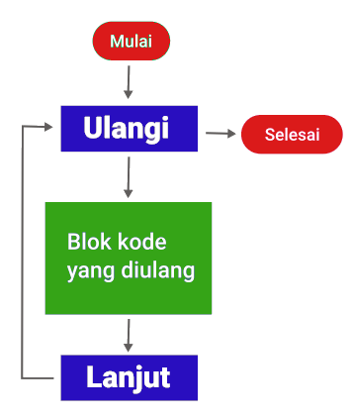

1. Counted Loop For

Slide 6
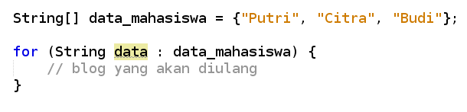
2. Counted Loop For Each
menampilkan isi dari array

Slide 7
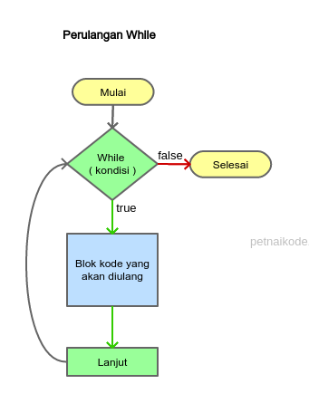
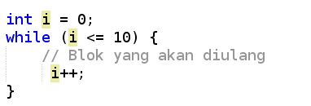
2. Uncounted Loop While

Slide 8
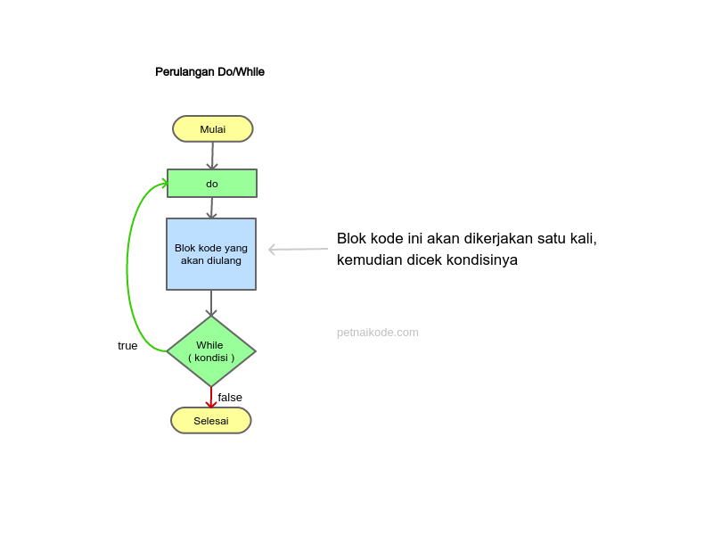
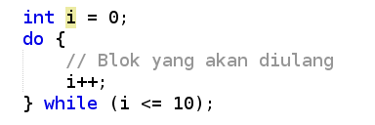
2. Uncounted Loop Do While

Slide 9
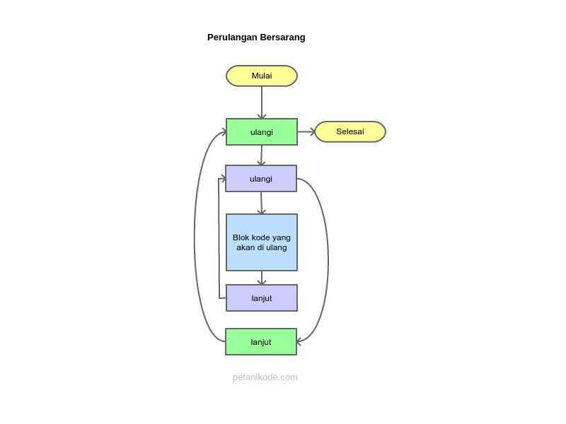
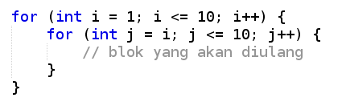
Nested Loop
Perulangan Bersarang

Slide 10
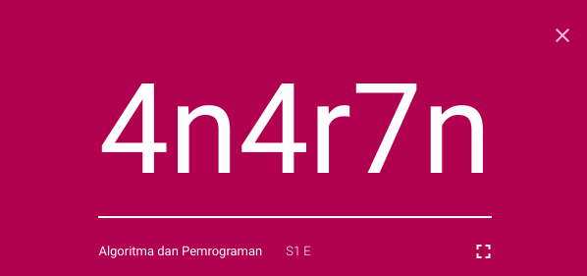
TUGAS
http://classroom.google.com

